Slide 1
REpeating Pattern Extraction Technique (REPET)
EECS 352: Machine Perception of Music & Audio

Slide 2


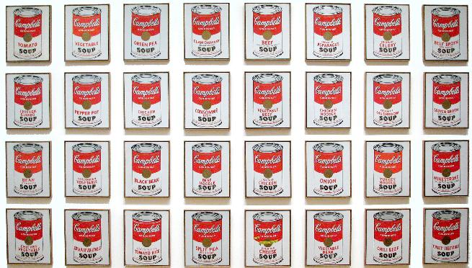
Observation
Repetition is a fundamental element in generating and perceiving structure
… in art
… in nature
[http://http://en.wikipedia.org/wiki/Campbell's_Soup_Cans]
… in audio

Slide 3

Observation
Musical works are often characterized by an underlying repeating structure over which varying elements are superimposed

Slide 4
Observation
Musical works are often characterized by an underlying repeating structure over which varying elements are superimposed

Slide 5
Assumption
There should be patterns that are more or less repeating in time and frequency
High energy
Low energy

Slide 6
Assumption
The repeating patterns could be identified and extracted using a time-frequency mask
1 = +repeating
0 = -repeating

Slide 7
Idea
REpeating Pattern Extraction Technique!
Identify the repeating elements
Derive a repeating model
Extract the repeating structure
REPET

Slide 8
Idea
Simple music/voice separation method!
Repeating structure = background music
Non-repeating structure = foreground voice
REPET

Slide 9
REPET
Step 1
Mixture Spectrogram V
Mixture Signal x
Beat Spectrum b
p
Step 2
V
Median
Repeating Segment S
1p
2p
Step 3
V
Repeating Spectrogram W
Time-Frequency Mask M
S
min
min
min

Slide 10

Practical Advantages
Does not depend on special parametrizations
Does not rely on complex frameworks
Does not require external information

Slide 11

Practical Interests
Karaoke gaming (need the music)
Query-by-humming (need the voice)
Audio remixing (need both components)

Slide 12
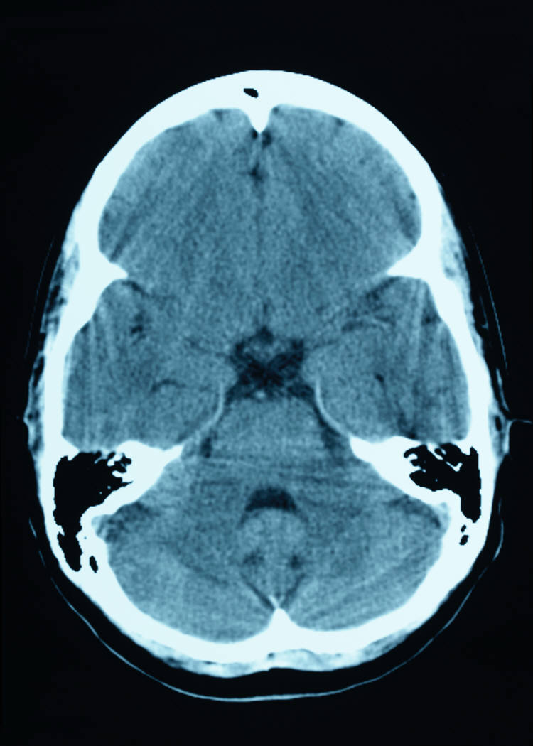
Intellectual Interests
Music understanding
Music perception
Simply based on repetition!

Slide 13



Parallels
Background subtraction in computer vision
Sequence of
video frames
Compare frames to estimate a background model

Slide 14
Parallels
Background subtraction in computer vision
Extracted varying foreground scene
Extracted fixed
background scene

Slide 15
Parallels
Background subtraction in computer vision
In audio, we also need to identify the repetitions!

Slide 16
Parallels
Background subtraction in computer vision
In audio, we also need to identify the repetitions!

Slide 17

Parallels
Auditory segregation in human listeners
?
?
Target identified as
the repeating object
?
Unknown audio mixtures
with the same target
and different distractors
Handsome professor

Slide 18
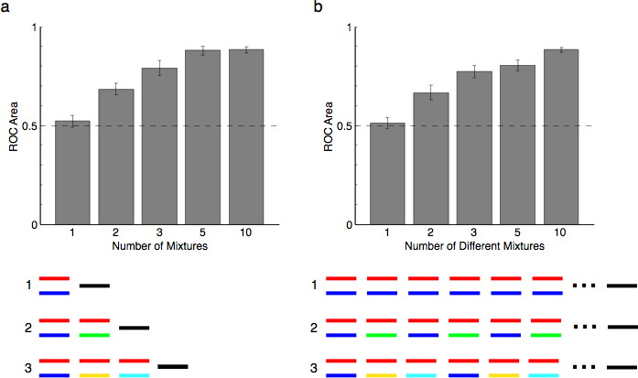

Parallels
Auditory segregation in human listeners
1 mixture:
2 mixtures:
3 mixtures:
5 mixtures:
10 mixtures:
As the number of mixtures increases,
the target becomes more apparent…
[courtesy of Josh McDermott]
red/black = target/probe,
other colors = distractors

Slide 19
REPET
Step 1
Mixture Spectrogram V
Mixture Signal x
Beat Spectrum b
p
Step 2
V
Median
Repeating Segment S
1p
2p
Step 3
V
Repeating Spectrogram W
Time-Frequency Mask M
S
min
min
min

Slide 20
1. Repeating Period
We compute the autocorrelations of the frequency rows of the mixture spectrogram
xcorr
xcorr

Slide 21
1. Repeating Period
We take the mean of the autocorrelation rows and obtain the beat spectrum
xcorr
mean

Slide 22

1. Repeating Period
The beat spectrum reveals the repeating period p of the underlying repeating structure
p

Slide 23
REPET
Step 1
Mixture Spectrogram V
Mixture Signal x
Beat Spectrum b
p
Step 2
V
Median
Repeating Segment S
1p
2p
Step 3
V
Repeating Spectrogram W
Time-Frequency Mask M
S
min
min
min

Slide 24
2. Repeating Segment
We then use the repeating period to segment the mixture spectrogram at period rate

Slide 25
2. Repeating Segment
We derive a repeating segment model by taking the element-wise median of segments
median

Slide 26
2. Repeating Segment
The median helps to derive a clean repeating segment, removing the non-repeating outliers
median
+ energy
- energy

Slide 27
REPET
Step 1
Mixture Spectrogram V
Mixture Signal x
Beat Spectrum b
p
Step 2
V
Median
Repeating Segment S
1p
2p
Step 3
V
Repeating Spectrogram W
Time-Frequency Mask M
S
min
min
min

Slide 28
3. Repeating Structure
We take the element-wise min between the repeating segment model and the segments
min

Slide 29
3. Repeating Structure
We obtain a repeating spectrogram model for the repeating background
min

Slide 30
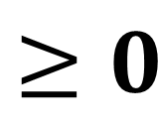
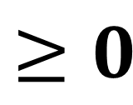

3. Repeating Structure
The repeating spectrogram should not have values higher than the mixture spectrogram
$$≥0$$
$$≥0$$
$$≥0$$

Slide 31
3. Repeating Structure
We then divide, element-wise, the repeating spectrogram by the mixture spectrogram
divides

Slide 32
3. Repeating Structure
We obtain a soft time-frequency mask (with values between 0 and 1)
divides

Slide 33
3. Repeating Structure
In the soft t-f mask, the more/less a t-f bin is repeating, the more it is weighted toward 1/0
median
division
+
-
+
-
1
0

Slide 34
3. Repeating Structure
We could further derive a binary t-f mask by fixing a threshold between 0 and 1
median
division
+
-
+
-
1
0

Slide 35
3. Repeating Structure
We multiply, element-wise, the t-f mask with the mixture STFT to get the background STFT
.x

Slide 36
3. Repeating Structure
We obtain the repeating background signal by inverting its STFT into the time domain
iSTFT

Slide 37
3. Repeating Structure
We obtain the non-repeating foreground signal by subtracting background from mixture
iSTFT

Slide 38

Summary
Repeating background ≈ music component
Non-repeating foreground ≈ voice component
REPET
Repeating period
Repeating segment
Repeating structure

Slide 39
Music/Voice Separation
A variety of techniques has been proposed to separate music and voice from a mixture
Accompaniment modeling, Pitch-based inference, Non-negative Matrix Factorization (NMF), etc.
Music
Music/Voice Separation
Mixture
Voice

Slide 40
Music/Voice Separation
Accompaniment modeling
Modeling of the musical accompaniment from the non-vocal segments in the mixture
→ Need an accurate vocal/non-vocal segmentation!
→ Need a sufficient amount of non-vocal segments!
Mixture spectrogram
Vocal/non-vocal segmentation
Music spectrogram

Slide 41
Music/Voice Separation
Pitch-based inference
Separation of the vocals using the predominant pitch contour extracted from the vocal segments
→ Need an accurate predominant pitch detection!
→ Cannot extract unvoiced vocals!
Mixture spectrogram
Predominant pitch detection
Voice spectrogram

Slide 42
Music/Voice Separation
Non-negative Matrix Factorization (NMF)
Iterative factorization of the mixture spectrogram into non-negative additive basic components
→ Need to know the number of components!
→ Need a proper initialization!
Mixture spectrogram
Bases
Activations
Music & voice spectrograms
≈

Slide 43
Evaluation
REPET [Rafii et al., 2013]
Automatic period finder
Soft time-frequency masking
Competitive method [Durrieu et al., 2011]
Source-filter modeling with NMF framework
Unvoiced vocals estimation
Data set [Hsu et al., 2010]
1,000 song clips (from karaoke Chinese pop songs)
3 voice-to-music mixing ratios (-5, 0, and 5 dB)

Slide 44
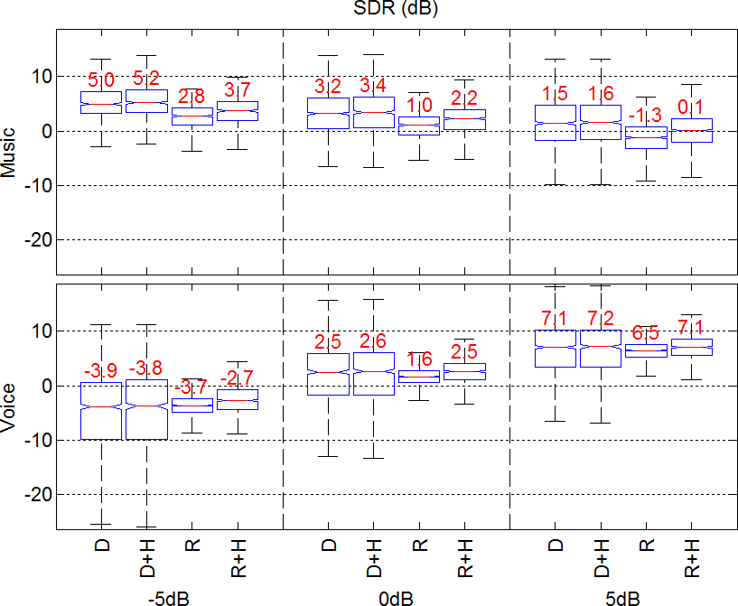
Evaluation
D = Durrieu
D+H = Durrieu + High-pass
R = REPET
R+H = REPET + High-pass

Slide 45
Evaluation
Conclusions
REPET can compete with state-of-the-art (and more complex) music/voice separation methods
There is room for improvement (+ high-pass, + optimal period, + vocal frames)
Average computation time: 0.016 second for 1 second of mixture! (vs. 3.863 seconds for Durrieu)

Slide 46
Examples
REPET vs. Durrieu (source-filter + NMF)

Slide 47
Examples
REPET vs. Ozerov (accompaniment modeling)

Slide 48
Examples
REPET vs. Virtanen (NMF + pitch-based)

Slide 49
Examples
REPET (more examples…)

Slide 50
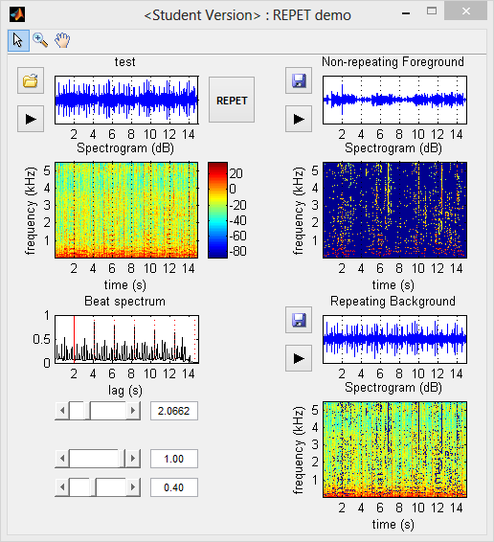
Demo

Slide 51

Thank you!

Slide 52
References
J.-L. Durrieu, B. David, and G. Richard, “A Musically Motivated Mid-level Representation for Pitch Estimation and Musical Audio Source Separation,” IEEE Journal on Selected Topics on Signal Processing, vol. 5, no. 6, pp. 1180-1191, October 2011.
C.-L. Hsu and J.S. R. Jang, “On the Improvement of Singing Voice Separation for Monaural Recordings Using the MIR-1K Dataset,” IEEE Transactions on Audio, Speech, and Language Processing, vol. 18, no. 2, pp. 310-319, February 2010.
A. Liutkus, Z. Rafii, R. Badeau, B. Pardo, and G. Richard, “Adaptive Filtering for Music/Voice Separation exploiting the Repeating Musical Structure,” in 37th International Conference on Acoustics, Speech and Signal Processing, Kyoto, Japan, March 25-30, 2012.
J. H. McDermott, D. Wrobleski, and A. J. Oxenham, “Recovering Sound Sources from Embedded Repetition,” in National Academy of Sciences, vol. 108, pp. 1188-1193, 2011.
A. Ozerov, P. Philippe, F. Bimbot, and R. Gribonval, “Adaptation of Bayesian Models for Single-Channel Source Separation and its Application to Voice/Music Separation in Popular Songs,” IEEE Transactions on Audio, Speech, and Language Processing, vol. 15, no. 5, pp. 1564-1578, July 2007.
M. Piccardi, “Background Subtraction Techniques: a Review,” IEEE International Conference on Systems, Man and Cybernetics, The Hague, Netherlands, October 10-13, 2004.
Z. Rafii and B. Pardo, “A Simple Music/Voice Separation Method based on the Extraction of the Repeating Musical Structure,” 36th International Conference on Acoustics, Speech and Signal Processing, Prague, Czech Republic, May 22-27, 2011.
Z. Rafii and B. Pardo, “Music/Voice Separation using the Similarity Matrix,” in 13th International Society for Music Information Retrieval, Porto, Portugal, October 8-12, 2012.
Z. Rafii and B. Pardo, “REpeating Pattern Extraction Technique (REPET): A Simple Method for Music/Voice Separation,” in IEEE Transactions on Audio, Speech, and Language Processing, Vol. 21, no. 1, pp. 22-27, January, 2013.
T. Virtanen, A. Mesaros, and M. Ryynänen, “Combining Pitch-based Inference and Non-Negative Spectrogram Factorization in Separating Vocals from Polyphonic Music,” ISCA Tutorial and Research Workshop on Statistical and Perceptual Audition, Brisbane, Australia, pp. 17-20, September 21, 2008.

Slide 53
Extensions
REPET works well on excerpts with a relatively stable repeating background (e.g., 10 s verse)
Mixture
Verse
REPET
Repeating background

Slide 54
Extensions
For full-track songs, the repeating background is likely to vary over time (e.g., verse/chorus)
Full mixture
Verse
Chorus
Verse
?
Full repeating background

Slide 55
Prior Segmentation
We could do a prior segmentation of the song and apply REPET to the individual sections
Full mixture
Verse
Chorus
Verse
REPET
REPET
REPET
Full repeating background

Slide 56
Sliding Window
We could apply REPET to local sections of the song over time via a fixed sliding window
Full mixture
Verse
Chorus
Verse
REPET
REPET
REPET
…
Full repeating background

Slide 57
Adaptive REPET
We could directly adapt REPET along time by locally modeling the repeating background
Full mixture
Verse
Chorus
Verse
Adaptive REPET
Full repeating background

Slide 58
Adaptive REPET
Step 1
Mixture Spectrogram V
Beat Spectrogram B
Mixture Signal x
p_{i}
i
i
Step 2
V
Median
Repeating Spectrogram U
i-1p_{i}
i
i+1p_{i}
i-1p_{i}
i
i+1p_{i}
i
Step 3
V
Repeating Spectrogram W
Time-Frequency Mask M
U
min

Slide 59
Original REPET
Step 1
Mixture Spectrogram V
Mixture Signal x
Beat Spectrum b
p
Step 2
V
Median
Repeating Segment S
1p
2p
Step 3
V
Repeating Spectrogram W
Time-Frequency Mask M
S
min
min
min

Slide 60
Generalization
REPET (and its extension) assumes periodically repeating patterns
Mixture
REPET
Periodically
repeating background

Slide 61
Generalization
Repetitions can also happen intermittently or without a global (or local) period
Mixture
?
Non-periodically
repeating background

Slide 62
Generalization
Instead of looking for periodicities, we can look for similarities, using a similarity matrix
Mixture
Similarity matrix
+similar
Beat spectrum/spectrogram
Non-periodically
repeating background
+dissimilar

Slide 63
Generalization
The similarity matrix is a matrix where each bin measures the (dis)similarity between any two elements of a sequence given a metric
Similarity matrix
Sequence
+similar
metric
i₁
i₂
+dissimilar
i₁
i₂

Slide 64
REPET-SIM
Similarity Matrix S
Step 1
Mixture Spectrogram V
Mixture Signal x
j₃
j₂
j₁
i
i
Step 2
V
Median
Repeating Spectrogram U
j₁
j₂=i
j₃
j₁
j₂
j₃
i
Step 3
V
Repeating Spectrogram W
Time-Frequency Mask M
U
min

Slide 65
Adaptive REPET
Step 1
Mixture Spectrogram V
Beat Spectrogram B
Mixture Signal x
p_{i}
i
i
Step 2
V
Median
Repeating Spectrogram U
i-1p_{i}
i
i+1p_{i}
i-1p_{i}
i
i+1p_{i}
i
Step 3
V
Repeating Spectrogram W
Time-Frequency Mask M
U
min

Slide 66
REPET + Pitch
REPET models the background rhythm
Pitch-based methods model the lead melody
Mixture spectrogram
“Period”
Rhythmic mask
Background rhythm
frequency
time
repetitions
(in time)
Mixture spectrogram
Melodic mask
Lead melody
“Pitch”
frequency
time
harmonics
(in frequency)

Slide 67

REPET + Pitch
Auditory processing in human listeners
Rhythm
Mixture
frequency
time
Melody

